Slide 1

Ozarks Alliance to End Homelessness FY26 HUD CoC Competition
Applicant Training
July 13, 2026

Slide 2

Welcome & Training Objectives
✓ MO-600's estimated funding availability
✓ How ARD, Bonus, and Reallocation funding work
✓ FY2026 federal priorities impacting project ranking
✓ Eligible new project types
✓ Local eligibility expectations for applicants
✓ Next steps in the CoC application process
Notes:
Welcome applicants and explain that this training is intended to provide a common understanding of the FY2026 competition before applications are submitted.

Slide 3
HUD Continuum of Care Overview
What is the Continuum of Care Program?
HUD's CoC Program:
Funds housing and services for individuals and families experiencing homelessness
Supports community-wide planning and coordinated responses
Requires collaboration among providers, people with lived experience, and community partners
Ozarks Alliance to End Homelessness Coverage Area
Springfield/Greene County Region:
Greene County
Christian County
Webster County
Lead Agency: City of Springfield

Slide 4
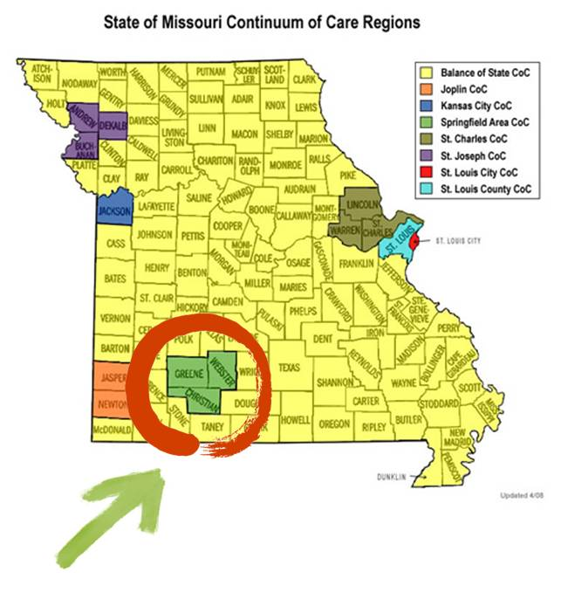
Ozarks Alliance to End Homelessness
Coverage Area
Springfield/Greene County Region:
Greene County
Christian County
Webster County
Lead Agency: City of Springfield
CoC Facilitating Agency: Community Partnership (CPO)

Slide 5

FY2026 Funding Overview
Estimated MO-600 Funding based on Annual Renewals Demand (ARD)
*Final funding amounts will not be confirmed
until HUD releases final competition information.
Funding Category | Amount
General CoC ARD | $1,586,350
DV ARD* | $159,066
CoC Bonus* 15% | $255,000
Estimated Total ARD | $1,745,416
This Photo by Unknown Author is licensed under CC BY-SA

Slide 6
Understanding Available Funding Sources
Funding Opportunities in FY26
Renewal Funding
  Existing CoC-funded projects requesting continuation.
Reallocation Funding
  Existing CoC funds redirected to a different eligible activity.
Bonus Funding
  Additional HUD funding available above ARD.
DV Bonus Funding
  Additional funding targeted toward projects serving survivors of domestic violence.

Slide 7
New Projects vs Reallocation Projects
New Bonus Project
Uses:
New HUD funding
Does not reduce existing renewals (ARD)
Examples:
New TH
New SSO
Reallocation Project
Uses:
Existing CoC renewal dollars
Requires shifting funding from an existing project
Examples:
Moving PSH funding to TH
Creating a new SSO project

Slide 8
Transition Grants
A Transition Grant allows a CoC to strategically modify an existing project.
Purpose: Move from one project type to another
Better align with HUD priorities
Preserve funding within the community
Examples:
PSH → TH
RRH → TH
Existing project → SSO

Slide 9
FY26 Federal Funding Changes
HUD is placing increased emphasis on projects that demonstrate:
  ✓ Housing stability
  ✓ Recovery supports
  ✓ Employment/self-sufficiency
  ✓ Strong supportive services
  ✓ Targeted interventions
Applicants should demonstrate:
  How participants will achieve long-term stability
  How partnerships support outcomes
  How success will be measured

Slide 10

National Scoring Process
HUD National Competition After local ranking:
HUD evaluates projects based on:
CoC application score
Project ranking
Project eligibility
Project performance
Federal priorities
Local ranking matters.
Projects ranked lower may have increased risk of losing funding.

Slide 11
Local Rank and Review
How Projects Will Be Evaluated
Performance
Housing outcomes
Utilization
Exits to permanent housing
Compliance
Monitoring history
Financial management
System Participation
Coordinated Entry
HMIS
Community engagement
FY2026 Priorities
TH
SSO
Recovery supports
Employment/self-sufficiency
Notes:
Scoring Sheets and Guide

Slide 12
Eligible New Project Types
FY2026 New Project Opportunities
Transitional Housing (TH)
Provides:
Temporary housing
Intensive services
Housing stabilization support
Supportive Services Only (SSO)
Examples:
Street Outreach
Targeted supportive services

Slide 13
Prioritized Vulnerable Populations
Federally Prioritized Populations
Domestic Violence Survivors
Consider:
Safety planning
Confidential services
Trauma-informed practices
Survivor-centered approaches
Youth Experiencing Homelessness
Consider:
Youth-specific services
Education/employment supports
Family reunification when appropriate
Youth leadership
Other local priority populations include Seniors and Families

Slide 14

Things to do Before Applying
Determine Eligibility & Research Match Requirements
  Is my agency eligible to apply?
  Can my agency meet the match requirements?
SAM Registration
Unique Entity Identifier (UEI)
Register for e-snaps
  Account to Submit Application
Consider HMIS or comparable database
Determine Project Type for Application

Slide 15
Application Timeline*
FY2026 Competition Timeline
July 21, 2026 Submission Deadline for Intent to Submit Form and Scoring Tool Narratives for New and Renewal Project Applications. Intent to Submit Forms/Renewal Narratives, in PDF, are due to Bob Atchley by 12:00 P.M. (NOON). Forms may be delivered in person to 840 Boonville, 2nd Floor Planning Department, Attn: Bob Atchley or emailed to batchley@springfieldmo.gov.
July 27, 2026 Deadline for All Project (Renewal/New/Reallocation) Applications. Applications from e-snaps, in a PDF format, due to Bob Atchley by 9:00 AM. Forms may be delivered in person to 840 Boonville, 2nd Floor Planning Department, Attn: Bob Atchley, or emailed to batchley@springfieldmo.gov.
July 29, 2026 NOFO Committee Meeting for Rank, Review, and Selection of New and Renewal applications.
July 29, 2026 Final Project Application Acceptance, Reductions, Rejections, and Rankings announced in
writing to Each Agency. Reasons for rejection or reductions will be included. Accepted applications Invited to Submit in e-snaps.
July 31, 2026 Deadline for All Project Appeals.
August 26, 2026 HUD COC Application Submission Deadline is 8:00 PM Eastern Time on Wednesday August 26th.
Please note all timelines and dates are subject to change, based on HUD deadlines or other factors.

Slide 16

Key Takeaways
✓ ARD protects renewal funding amounts
✓ Bonus funds are additional opportunities
✓ Reallocation shifts existing resources
✓ HUD priorities have changed
✓ Strong performance remains critical
✓ New projects must demonstrate system impact

Slide 17
HUD CoC Resource Page: HUD Exchange
  CoC Competition Page on HUD.Gov https://www.hud.gov/program_offices/comm_planning/coc/competition
  HUD Exchange – CoC Eligible Activities
  CoC Eligible Activities - List of CoC Eligible Activities - HUD Exchange
  HUD Exchange – Match Requirements
  CoC Match - Match Requirements - HUD Exchange
  HUD.gov email addresses for questions
  cocnofo@hud.gov for questions about the NOFO, competition, and applications.
  e-snaps@hud.gov for questions about e-snaps technical issues.

Slide 18
MO-600 Continuum of Care
Ozarks Alliance to End Homelessness
Questions can be sent to:
Michelle Garand
mgarand@cpozarks.org
Or
Bob Atchley
batchley@springfieldmo.gov
Thank you!
Notes:
We are not experts in program specifics. Use HUD Exchange, AAQ, Peer Support, and other resources.

